Slide 1
PLAN B
Preliminary Design Review

Slide 2
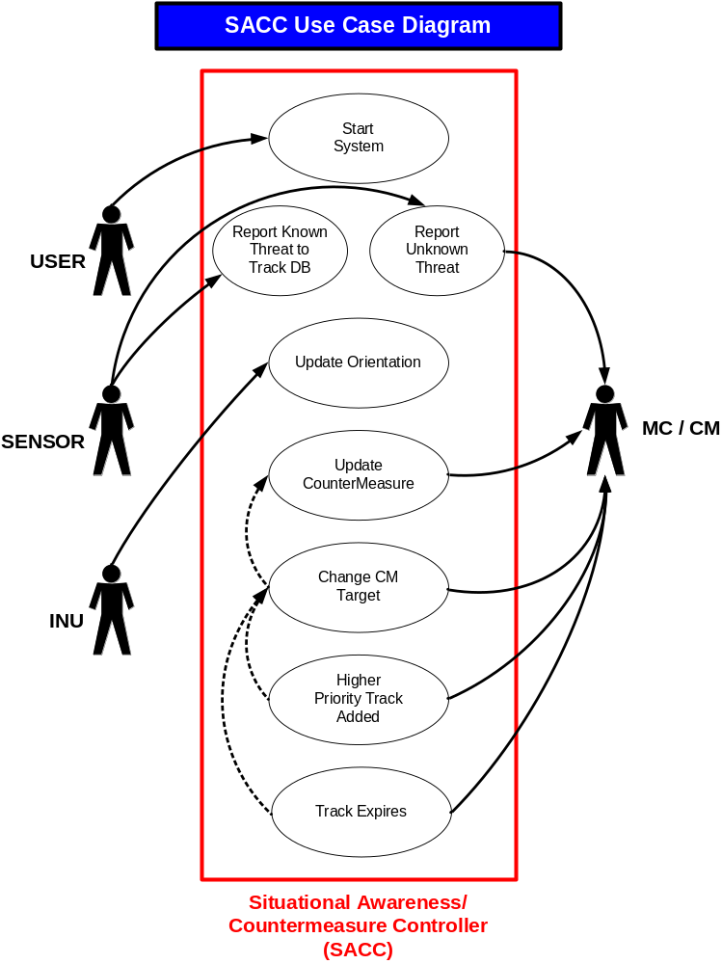
Use Case Diagram

Slide 3
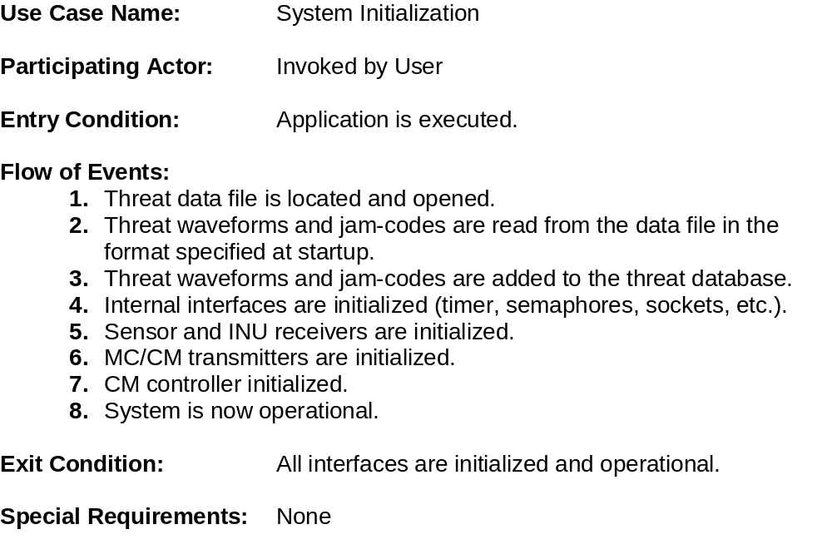
Use Case 1

Slide 4
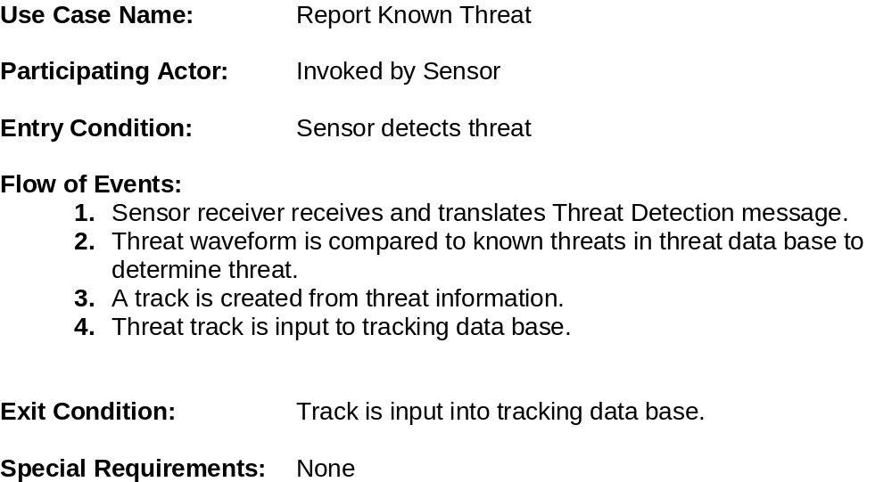
Use Case 2

Slide 5
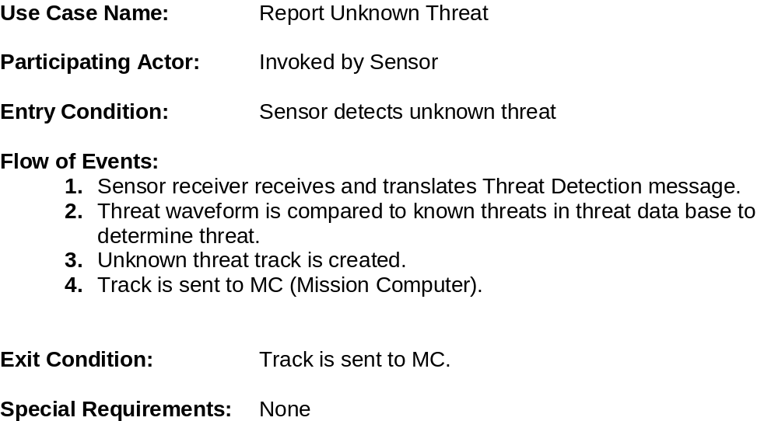
Use Case 3

Slide 6
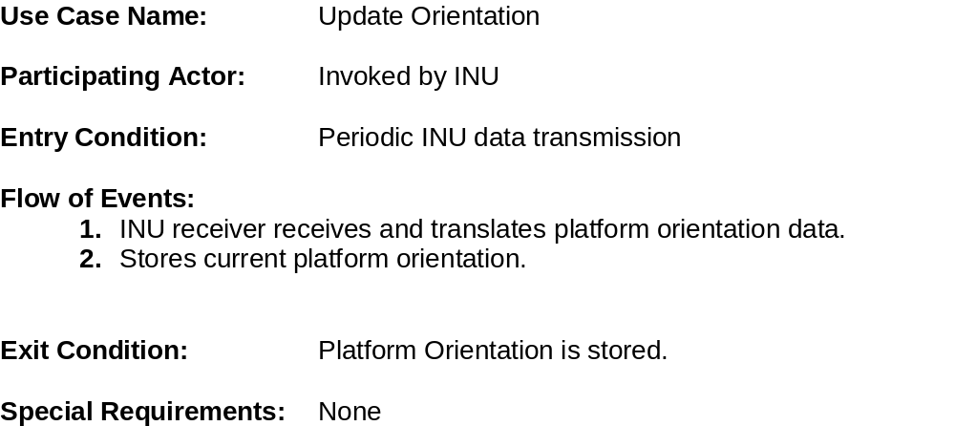
Use Case 4

Slide 7
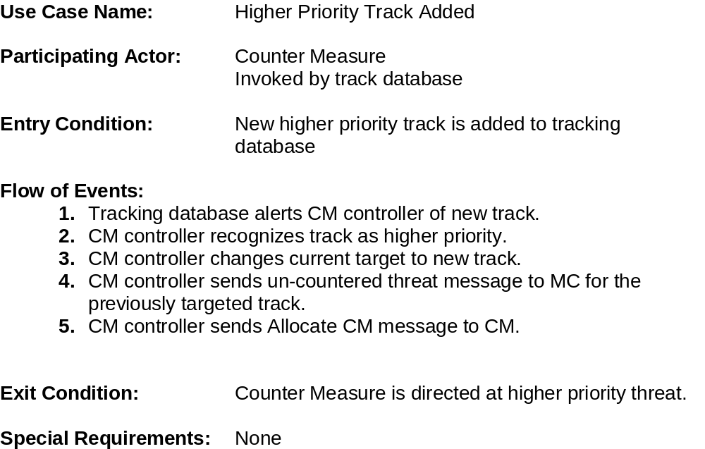
Use Case 5

Slide 8
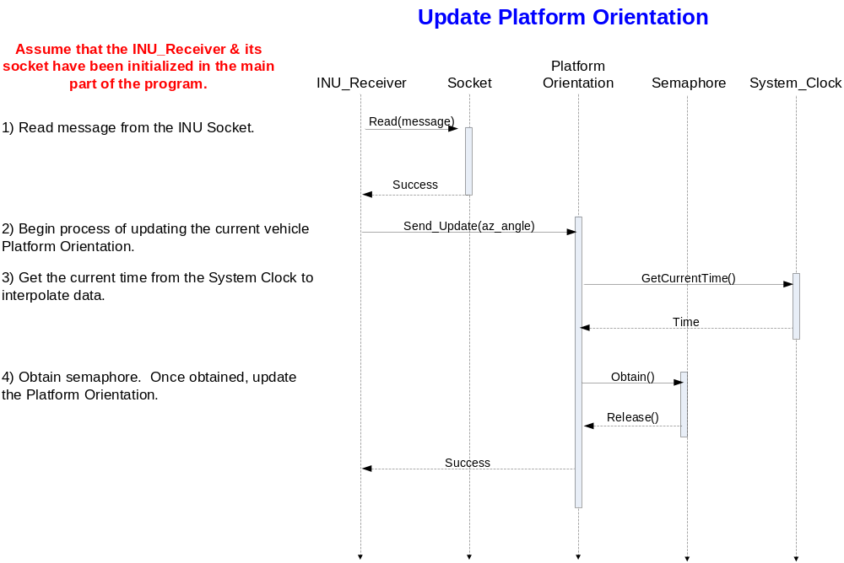
Sequence Diagram 1

Slide 9
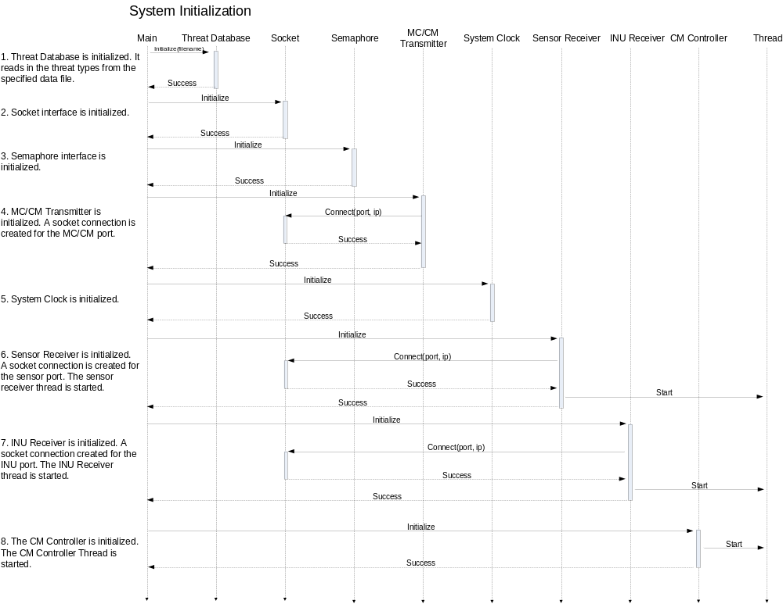
Sequence Diagram 2

Slide 10
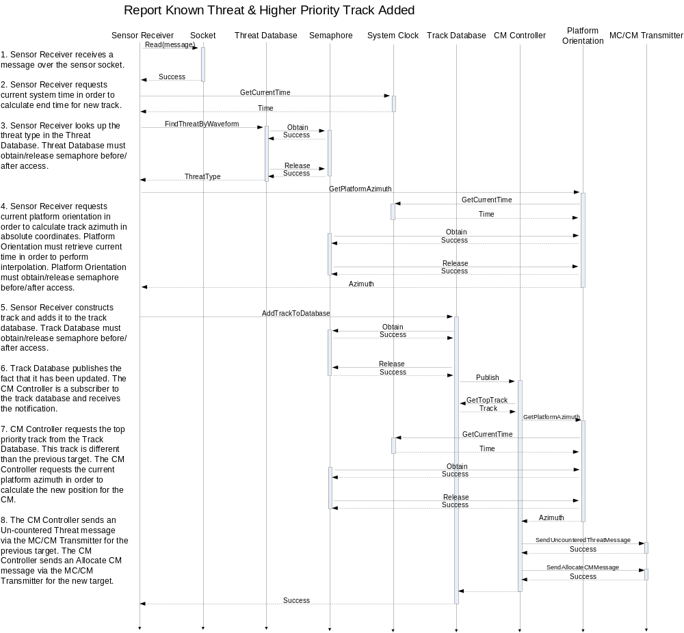
Sequence Diagram 3

Slide 11
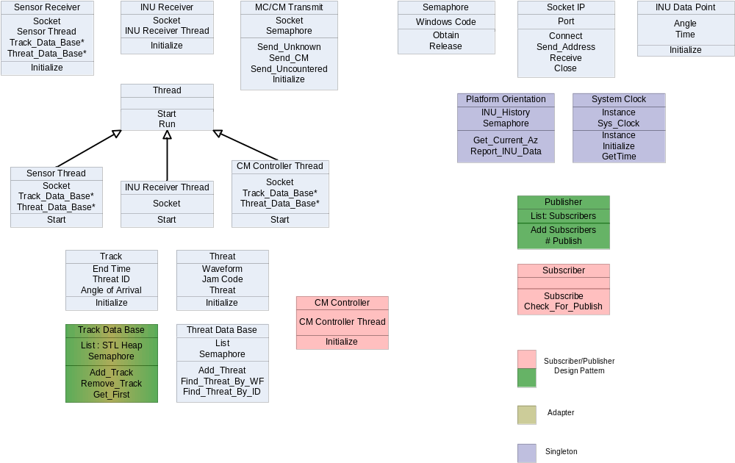
Class Diagram

